Slide 1

Learning Dreamweaver:
The Basics &
Instructional Strategies
Dr. Tena B. Crews
Director of Business Education
University of South Carolina
&
Ms. Cara S. Norton
Dacula High School
Gwinnett County, GA

Slide 2

Components of Dreamweaver
Are you familiar with FrontPage?
Dreamweaver is FrontPage on steroids.
These icons are not there:
It is a Macromedia Product
Define a Local Site
Insert Toolbar
Property Panels
New environment!

Slide 3

Common Panel
Hyperlink
Email Link
Named Anchor
Insert Table
Draw Layers
Image
Image Placeholder
Fireworks HTML
Flash
Rollover Image
Navigation Bar
Horizontal Rule
Date
Tabular Data
Comment
Tag Chooser
Draw Layout Table
Draw Layout Cell
Standard View
Layout View

Slide 4
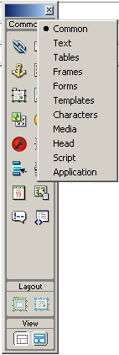

Other Panels
It depends on what
you're working on!

Slide 5

Text Properties Inspector
Different Colors
Different Sizes
Different Fonts
Alignment, Style, Bullets, Numbers, etc.

Slide 6

Tables Properties Inspector
Lions | Tigers | Bears
10 | 3 | 5

Slide 7
Page Properties
Modify
  Page Properties
Be consistent with
  Margins
  Fonts
  Page Titles
  Colors
To develop an effective, consistent page
To develop a user comfort zone

Slide 8
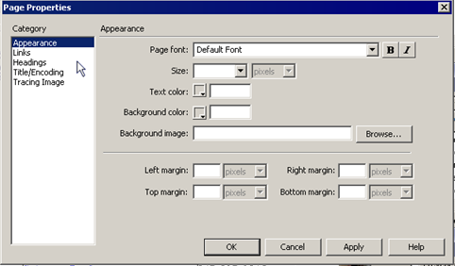
Page Properties
Can choose font combination. If the user does not have one, the next font is tried, etc.
Most everything based on Cascading Style Sheets
(CSS)

Slide 9
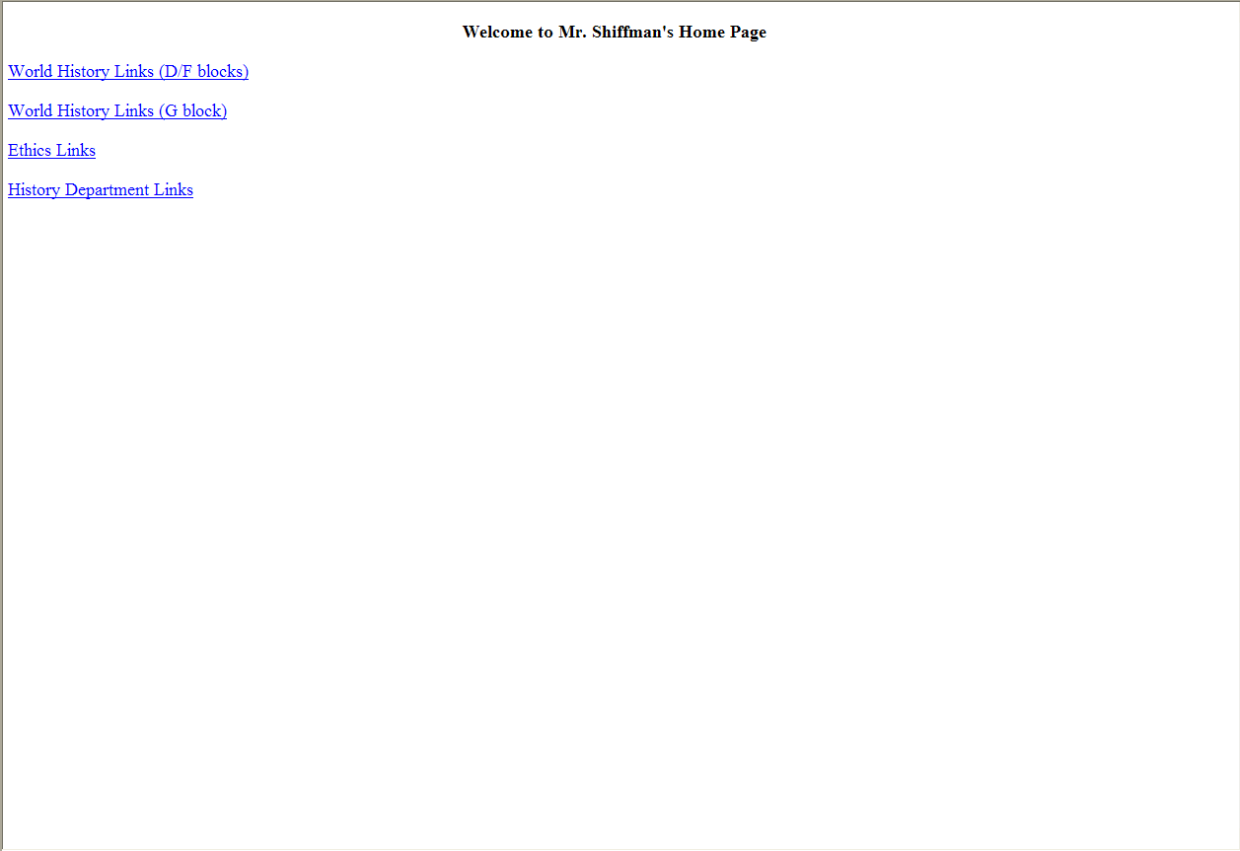

The Good, Bad, & Ugly

Slide 10

The Good, Bad, & Ugly

Slide 11

The Good, Bad, & Ugly

Slide 12
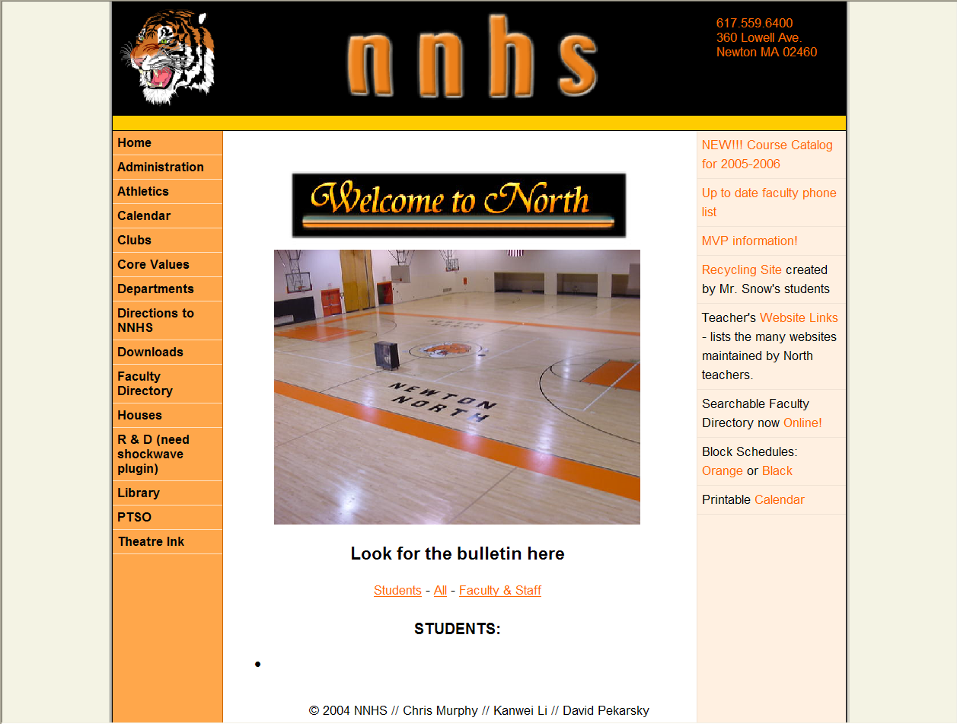
The Good, Bad, & Ugly
To use frames or
not to use frames. . .
that is the question

Slide 13
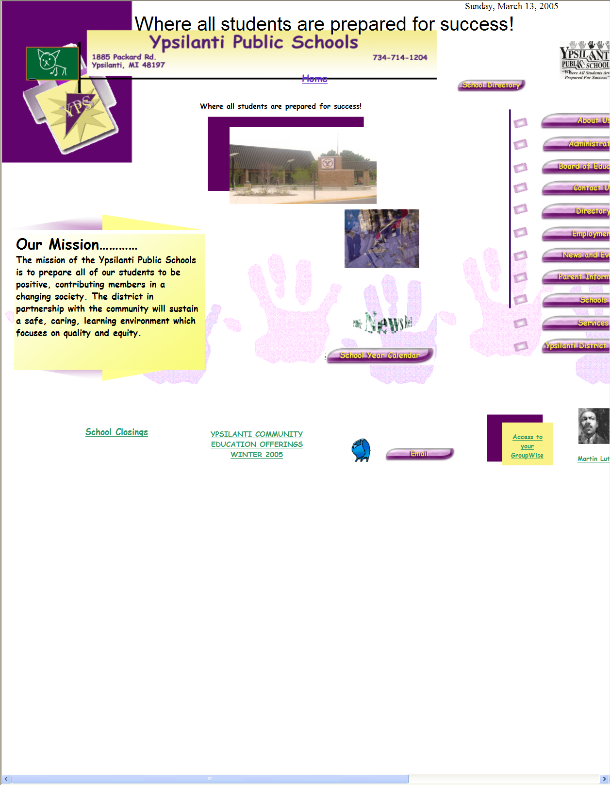
The Good, Bad, & Ugly

Slide 14

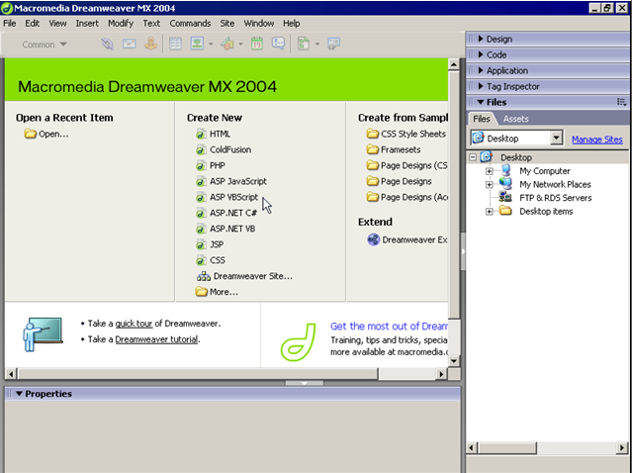
DW Start Screen
Go ahead!
Start Dreamweaver!
Typically for new web page choose Create New - HTML

Slide 15
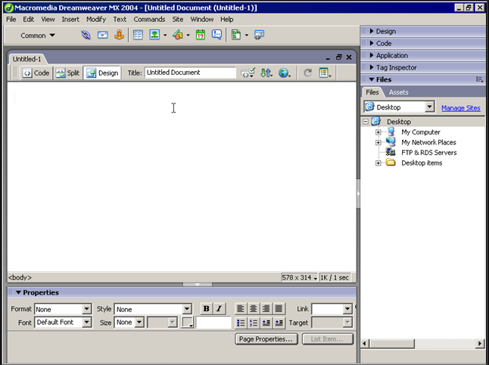
Document Window
Insert Toolbar
Can get everything from Insert Menu too
Gripper to move panel
Triangle expands panel
Document Toolbar
Display view options
Panel options menu
Preview in Browser
F12
Tag selector
Will select text in body if you click on <body>
Panel Well
Window Size
  Average Resolution on computers (800 x 600) -- Which is 760 x 420 pixels
Expand/Condense screen/panel well
Page size and download indicator
Properties Panel
Properties panels always show up at bottom of screen

Slide 16

Download Time
Watch Page Size & Download Indicator
Most people wait 3-5 seconds for a page to download
  Some people say 10 seconds
If someone has 56K modem
  A 65K page “should” load in 10 seconds

Slide 17

Function Keys
F4
  Show and Hide Toggle Switch
    Panels
    Insert Toolbar
    Properties
F12
  Preview in Browser
    Don’t need Internet access

Slide 18
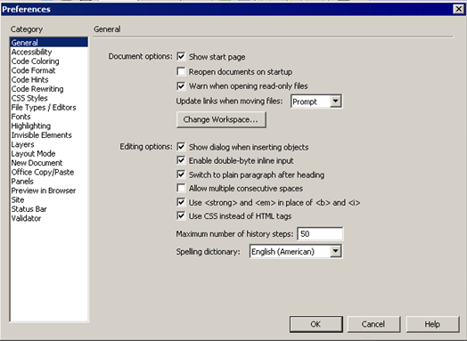
Edit - Preferences
To set Dreamweaver and your preferences

Slide 19

Site Planning
You want your web page to meet user’s needs
More planning = better implementation
Better implementation = meeting user’s needs
Considerations:
  Site Goal
  Target Audience
  Tools and Platform
  Site Design

Slide 20

Site Goal
What is your theme?
What is your goal?
  Informational
  Educational
  Entertainment
  Purchasing
Mission Statement
  Whether visible or not, follow it

Slide 21

Target Audience
What browser and version are they using?
Four most common:
  Internet Explorer, Mozilla, Netscape and Opera
What hardware are they using
  Remember average screen resolution
    800 x 600
What is their connection speed?
  Average still 56K
How much do they know about using
computers and the Internet?
  Children vs Professionals

Slide 22
Does everyone see what you see?
WYSIWYG!
Some times in some browsers.
So, use tables!

Slide 23

Tools & Platform
Are you just using Dreamweaver?
  Probably not
Flash for animation
Premier for video
Fireworks or Photoshop for image design/tweaking
Excel for spreadsheets/charts
Word or .pdf files
  What does pdf stand for?
    Portable Document Format

Slide 24

Site Design
Before touching Dreamweaver
Do one of the following
  Create outline
  Create flowchart
  Create storyboard/mock up
What are your
  Colors?
  Logo?
  Layout?
  Number of pages?
  Etc.
Where does everything go?
Where is everything that’s going there?

Slide 25

Before we get started. . .
Where shall we save our files today?
Create a folder on your desktop
  My Web Page
Create a folder inside the My Web Page folder
  Images
Why do we do this?
Explanation!

Slide 26
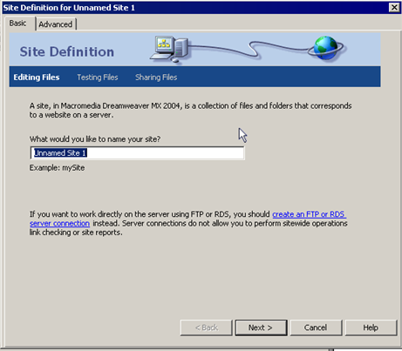
Defining a Local Site
Completing a few small steps will make life easier later!
Site
  Manage Sites
  New
  Site
My Web Site
Let's do this
together!
Site Definition Wizard

Slide 27
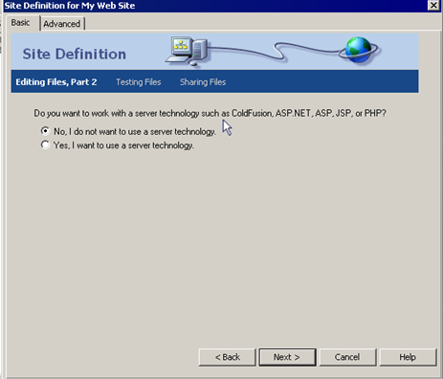
Defining a Local Site
If you wanted to make your web page more interactive with
  Forms
  Passwords
  Etc.
For us today – No!

Slide 28
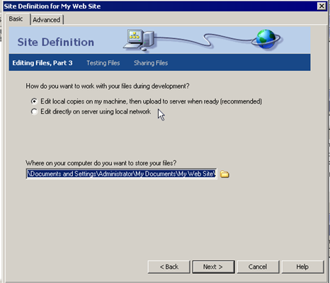

Defining a Local Site
What do you think?
Edit locally?
Edit on server?
Do NOT click Next yet!

Slide 29
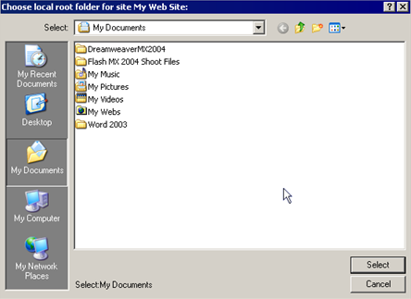
Defining a Local Site
Click on folder and choose folder to store files.

Slide 30
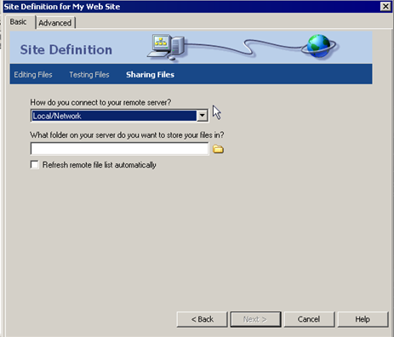
Defining a Local Site
Remote Site
You?
Techy Person?
For us today – Choose None!

Slide 31
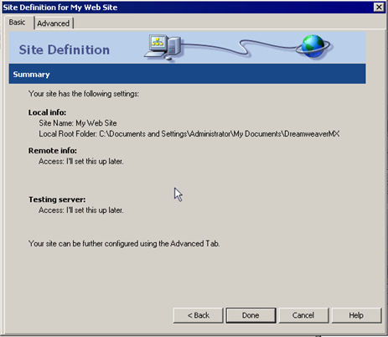
Defining a Local Site
Summary
Can go back

Slide 32
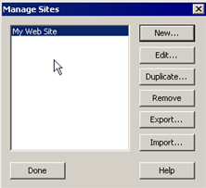
Defining a Local Site
DONE!

Slide 33
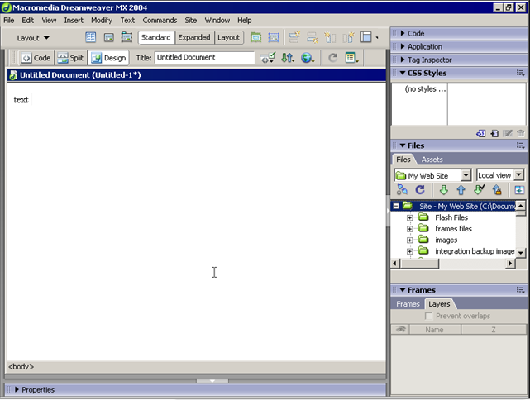
Defining a Local Site
See files in Files Pane
Expand

Slide 34
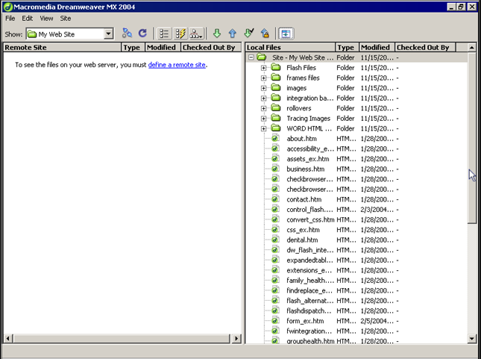
Defining a Local Site
Remote
Local

Slide 35


YOU DID IT!

